Slide 1





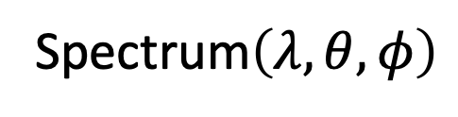


$$θ<{90}^{o}$$
$$I\left(θ,φ\right)$$
L₀
ray optics
CS:1
EM wave optics
Spectrum$\left(λ, θ,φ\right)$
L₁
ray optics
CS:2
EM wave optics
$$θ_{1},φ_{1}$$
$$θ_{2},φ_{2}$$
$$……$$
ray optics
emitter
EM wave optics
$$θ_{3},φ_{3}$$
z
$$……$$
ray optics
$$λ$$
CS:n-1
EM wave optics
L_{n-1}
ray optics
CS:n
EM wave optics
L_{n}
ray optics
x
$$θ>{90}^{o}$$

Slide 2

start
Load Material/User
start
Load Structure/Structure List
$$θ, φ$$
Output setup (plot/write)
Calculate
far field

Slide 3





$$z$$
Detector
$$θ$$
$$y$$
$$φ$$
$$x$$

Slide 4
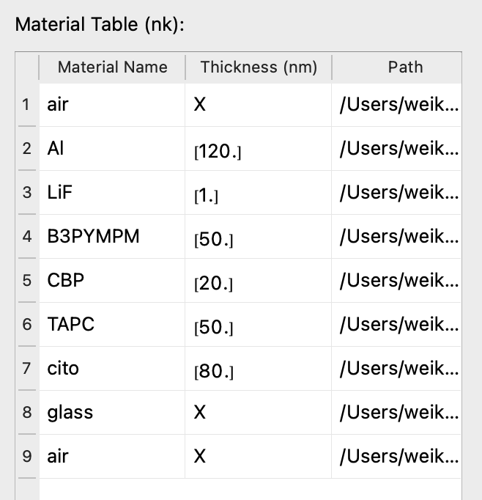
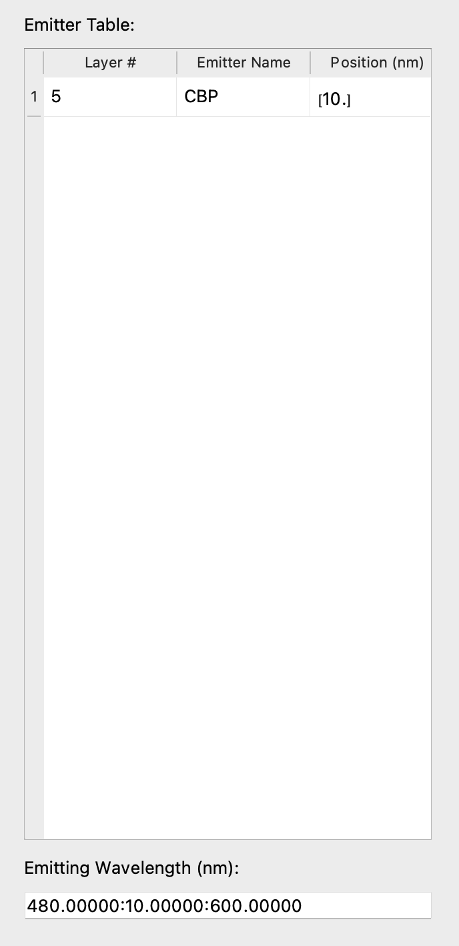
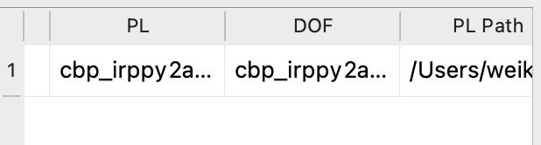
(a) device structure
(b) EML
(c) emitting wavelength

Slide 5
(a)
(b)

Slide 6
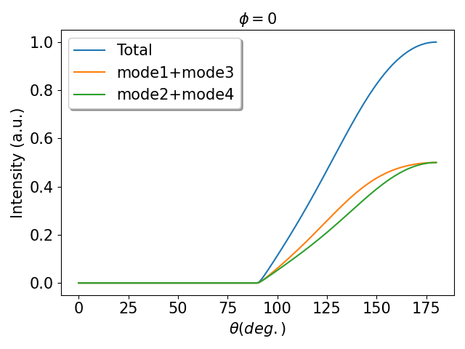
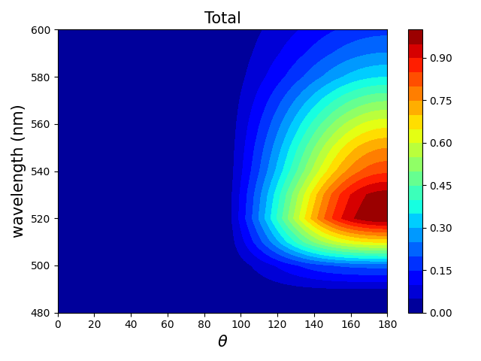
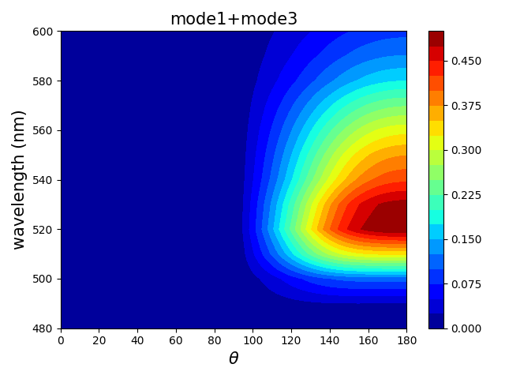
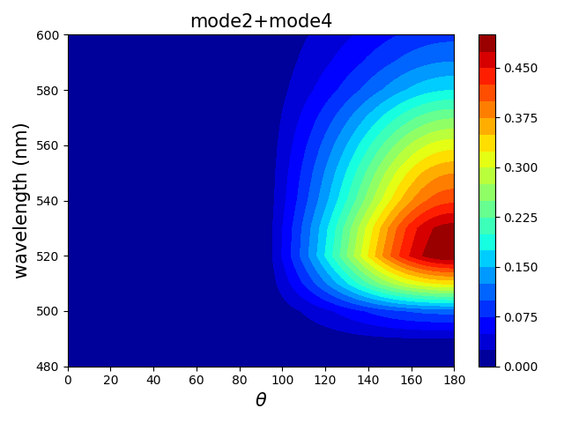
(a)
(b)
(c)
(d)

